Slide 1
Dogs vs Cats Covnet classifier
By Rajat Shrestha
L3C4 Islington College

Slide 2
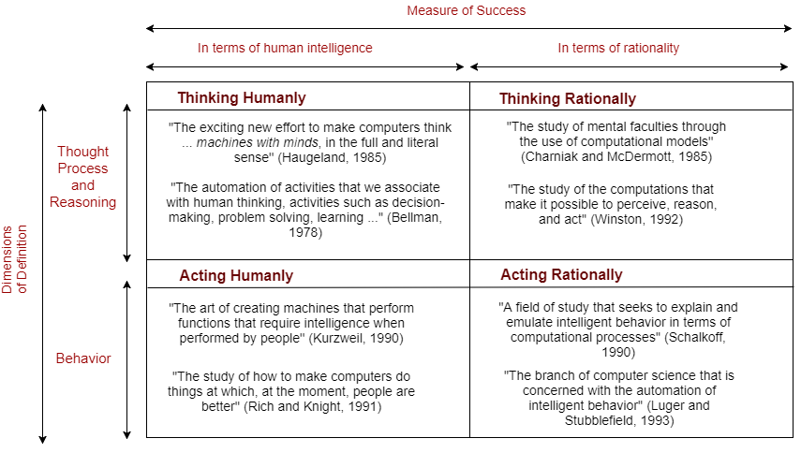
What is Artificial Intelligence?
Smart Machines with
Intelligent behavior.
Strong AI:
Think Humanly
Think Rationally
Weak AI:
Act Humanly
Act Rationally

Slide 3

Machine Learning
It is exactly what it sounds like,
It’s the process of programming
Machines to make them learn instead
of explicitly programming them. Then
After the learning phase the machine
Can act smartly on similar circumstances

Slide 4
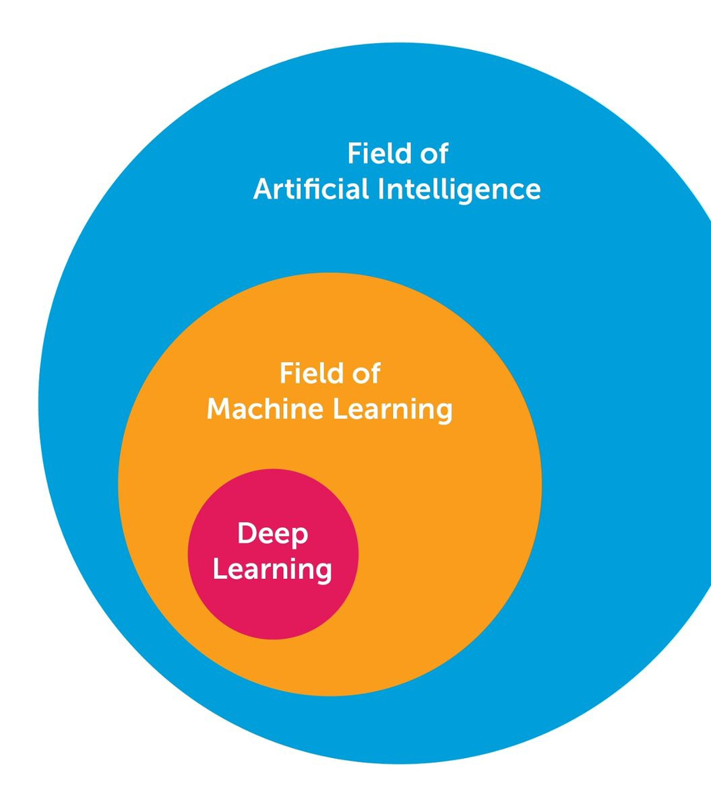
Deep Learning
ML but inspired by biological model of Neurons
Deals with complex Multilayer Perceptrons:
Multiple Hidden Layers
Many Operations and Neurons
Resource Intensive
Effective in classifying images
Recently Popular Due to:
Large amount of data
Advancements in Algorithms
Better GPUs/CPUs/TPUs

Slide 5
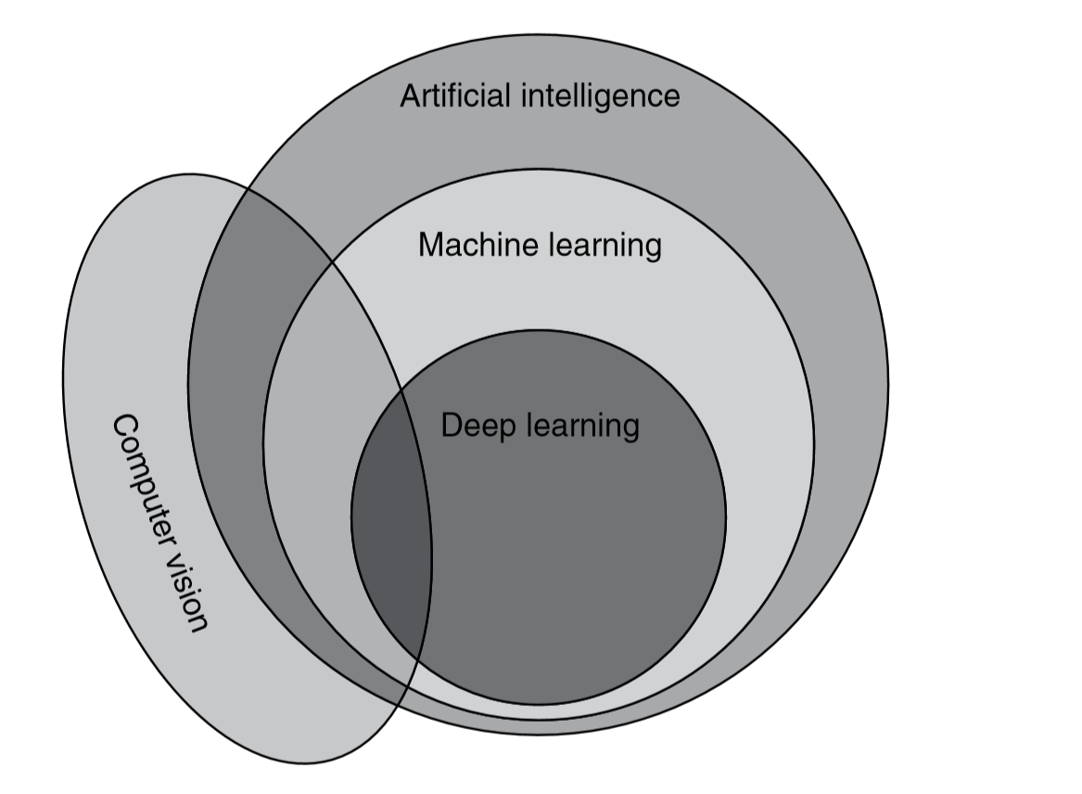
Computer Vision
Field of study that seeks to develop techniques to help computers “see” and understand the content of digital images
Due to the boom in Deep Learning, a vast use cases of computer vision are improved
Computer Vision overlaps along with the concept of AI/ML and deeplearning

Slide 6
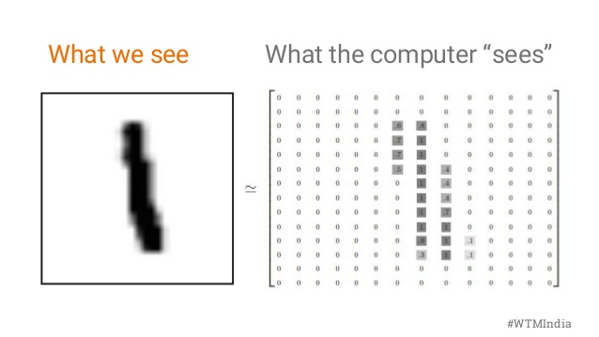
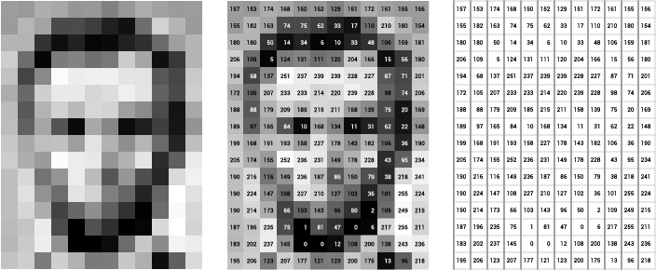
Problem Statement
People and other intelligent living beings can easily distinguish between various different species of animals as we have been seeing them since our birth
But computers cannot see images as we do.
Computer only sees numbers
This project details how numbers can be manipulated so that the information can be extracted by the computers
It is even trickier to program computers to distinguish cats and dogs due to the similar high level features.

Slide 7
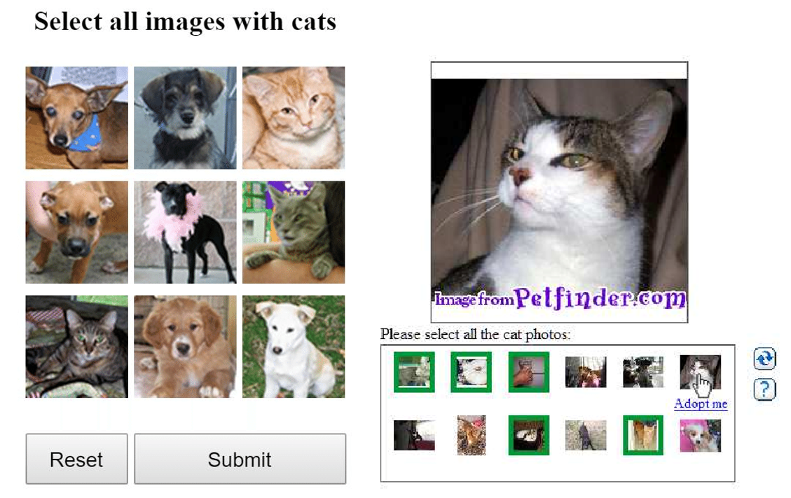
ASIRRA dataset
Animal Species Image Recognition for Restricting Access
Released by Microsoft Research (MSR) proposed the
Used to discriminate computers from humans in Web
Is a CAPTCHA (Completely Automated Public Turing Test to Tell Computers and Humans Apart)
The computers in the past were not equipped with capabilities to recognize dogs from cats.
Now this system is obsolete and is used as a base standard for practicing Machine learning concepts such as CNN.

Slide 8
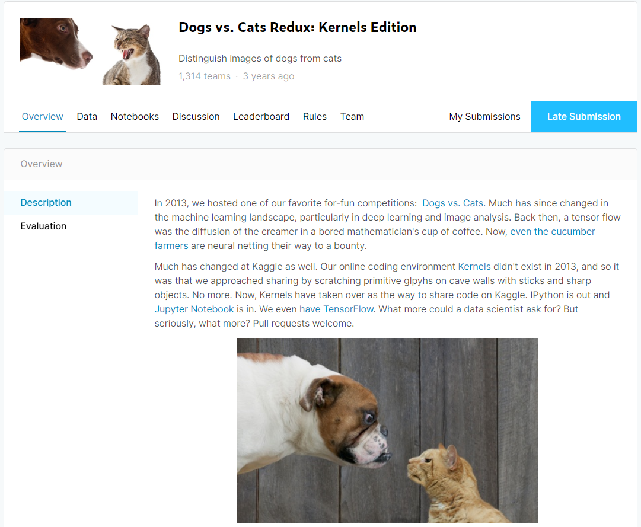
Kaggle Competition
The challenge for classifying Dogs from cats was released at 2013 after the huge success of AlexNet.
Later after Kaggle introduced Kaggle kernel, this competition was re-introduced in 2016
A lot of participants competed in this challenge
There are a lot of guides and notebooks on classifying Dogs and cats

Slide 9
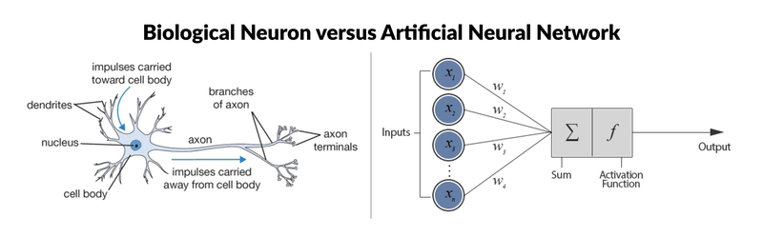
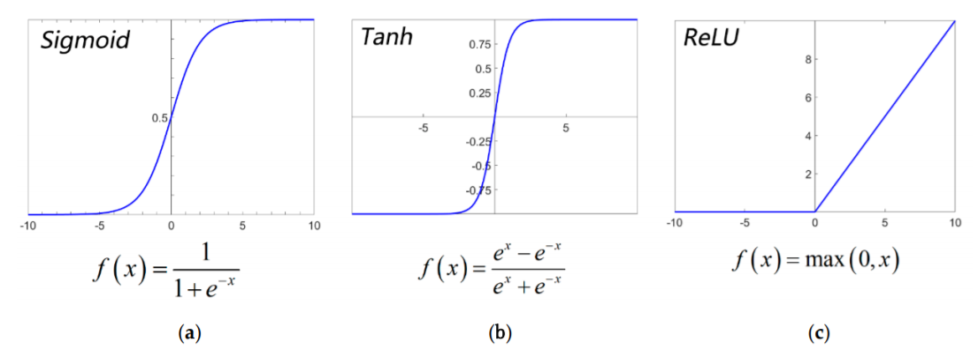
Perceptron or Artificial Neuron
Mimics a biological neurons
Multiple inputs
Connected to other neurons
A basic part of an Neural Network
Has a specific Activation Function
Perceptron Compared to an
Actual neuron
Various Activation Functions

Slide 10
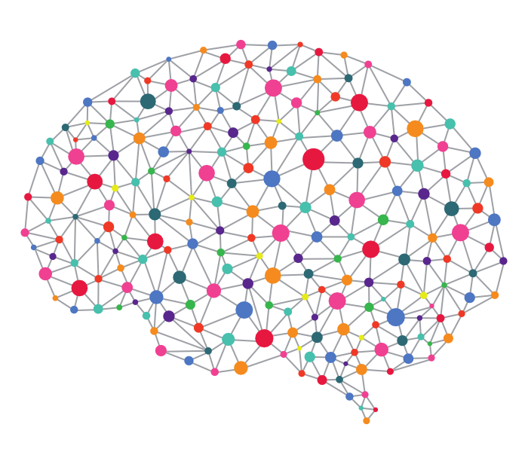
Neural Networks
Known as Artificial Neural Networks(ANN)
Networks of multiple Perceptrons loosely modelled after a biological brain
A deep neural network is a type of ANN with hidden layers(layer of neurons between the input and output layers)
Deep neural Networks are also known as Multi-Layered Perceptrons due to their arrangements of neurons
Each connection in a neural network enables the neuron to transmit a signal to other neurons.
Neural networks often consist of large numbers of “neurons”.

Slide 11
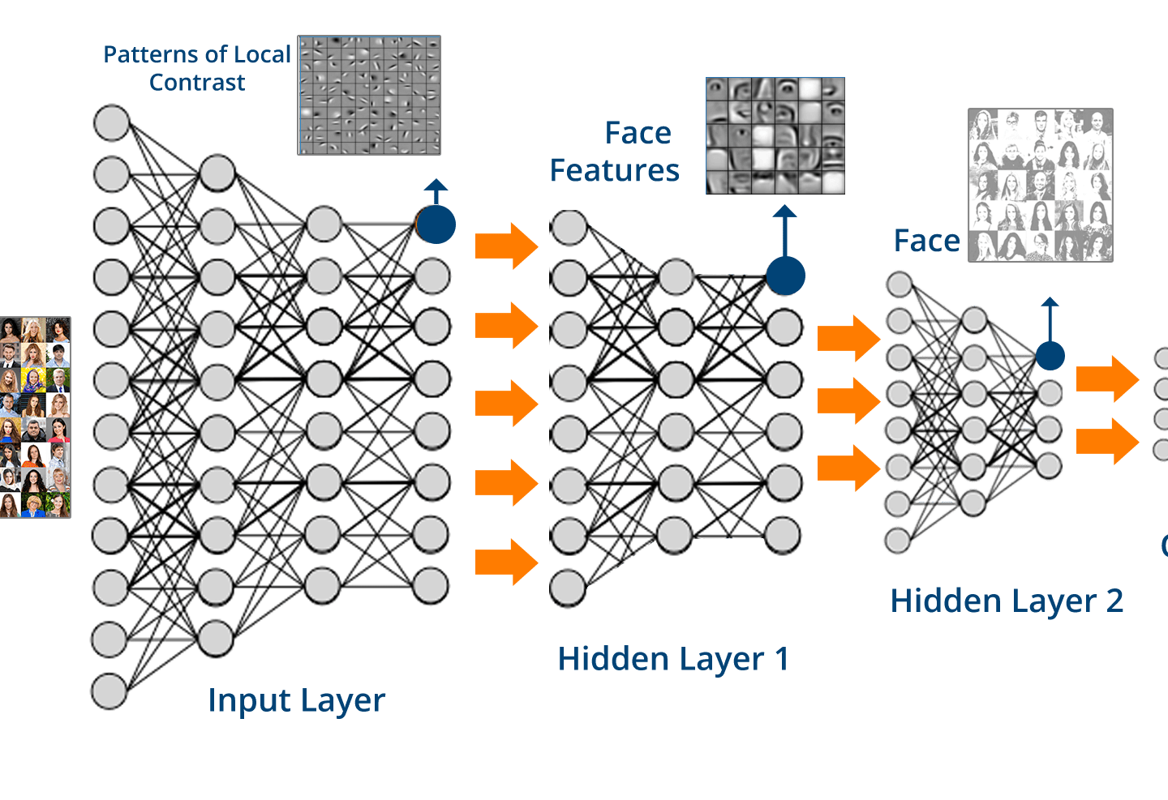
Convolutional Neural Network
Feed forward Neural network (FFNN)
Space Invariant Artificial Neural Networks (SIANN)
Consists of:
Convolutional Layer
Activation Function
Pooling Layer
Fully Connected Layer
Good for Classifying Images
Embarrassingly parallel

Slide 12


Convolution operation
The main purpose of a convolution operation is to:
Detect patterns
Basic Shapes
Makes these details sharper
Uses a kernel which strides throughout the input image.
The Convolution operation is usually followed by an activation layer

Slide 13


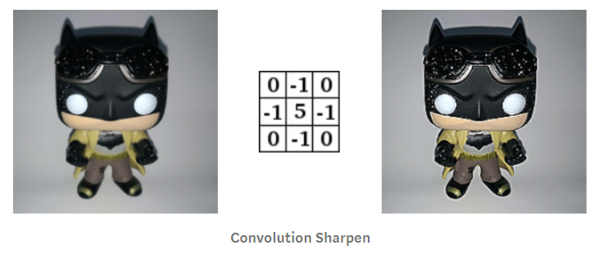
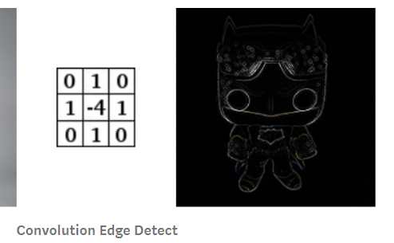
Kernel
Convolution matrix, or mask is a small matrix.
It is the fundamental operation in CNN
When multiplied with the same sized part of the image will produce the new image with added effects.
A convolution operation will reduce the size of the image but can easily be mitigated by adding a masking layer to the input image.

Slide 14

Convolution operations in RGB images
Convolution operation basically the same
Each layer will have its own convolution operation
The output of all of the convolutions will be added to give the final results

Slide 15
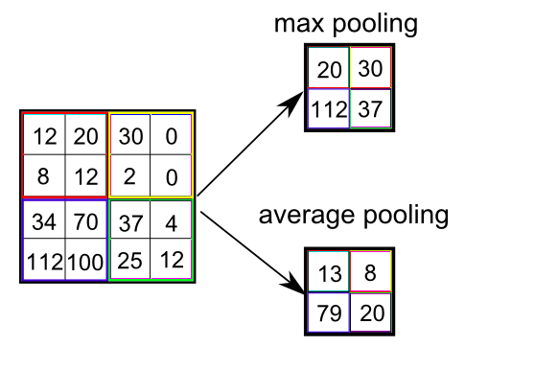
Pooling Layer and Max Pooling
Similar to convolution operation the ﬁlter is applied using a sliding window approach.
The pooling layer applies a ﬁxed operator, usually either max or average.
Pooling has hyperparameters:
the size of the ﬁlter and the stride.
An example of max pooling with ﬁlter of size 2 and stride 2 is by shrinking the 2 by 2 matrix to a single maximum value within the matrix as shown
Pooling is applied after a convolution layer to highlight the main feature.
Depth of the image is conserved unlike in convolution
Max pooling is used more often since it gives results by highlighting the main feature and decreasing the chance of overfitting.
Pooling contributes to the increased accuracy of the model and improves the speed of training due to the reduction in the number of parameters of the neural network

Slide 16
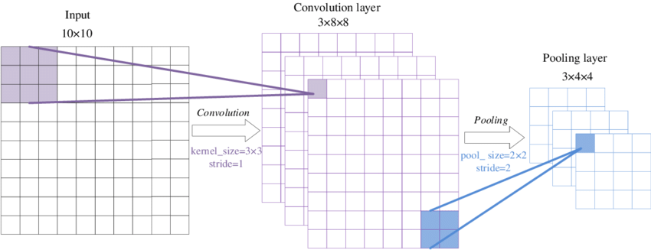
Convolution and Pooling in CNN
The Convolution Operation is quickly followed by a Pooling layer
Both of the operation goes through a sliding window procedure
The output image is significantly smaller than the input image
This will make the image go through Various Filter operation and highlight the features
This reduces the chance of overfitting.

Slide 17
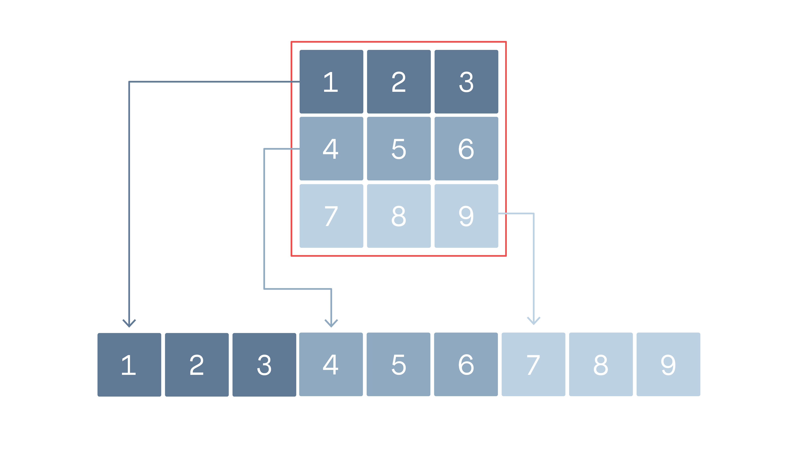
Flatten This will Flatten The matrix to a single dimension This is usually the first operation in the fully connected layers
Fully Connected Layers
The main Layer for classifying the images

Slide 18
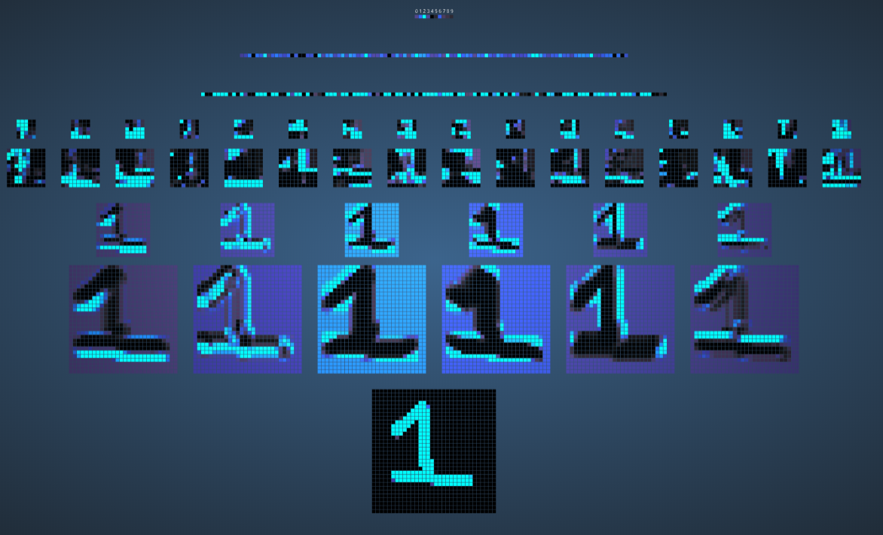
Visualization of a CNN
https://www.cs.ryerson.ca/~aharley/vis/conv/flat.html

Slide 19
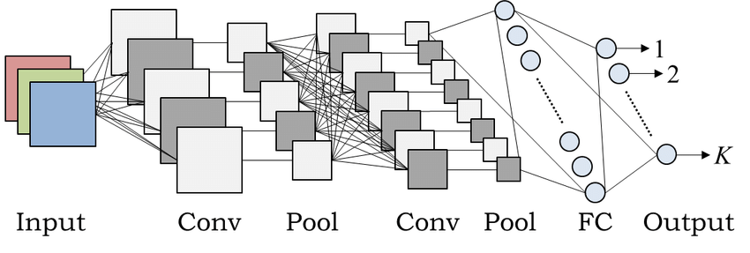
CNN Architectures
Simple Architectures:
Le-Net
Alex-Net
VGG-16
Complex Architectures
ResNet-50
Inception-v1
Inception-v3

Slide 20
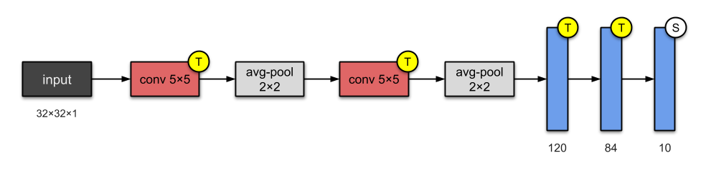
Le-Net
Created by Yann LeCun in 1998
1st CNN model proposed to solve a problem
Was used for digit recognition
2 Convolution Layers
2 Pooling Layer
3 Fully Connected Layers
60,000 Parameters

Slide 21
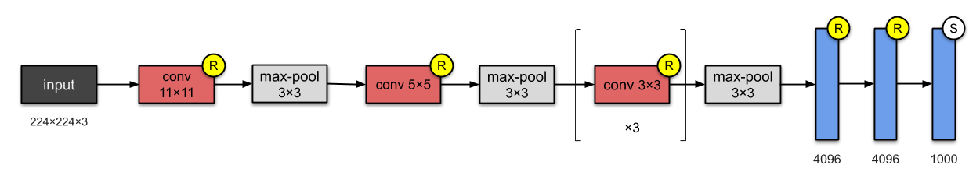
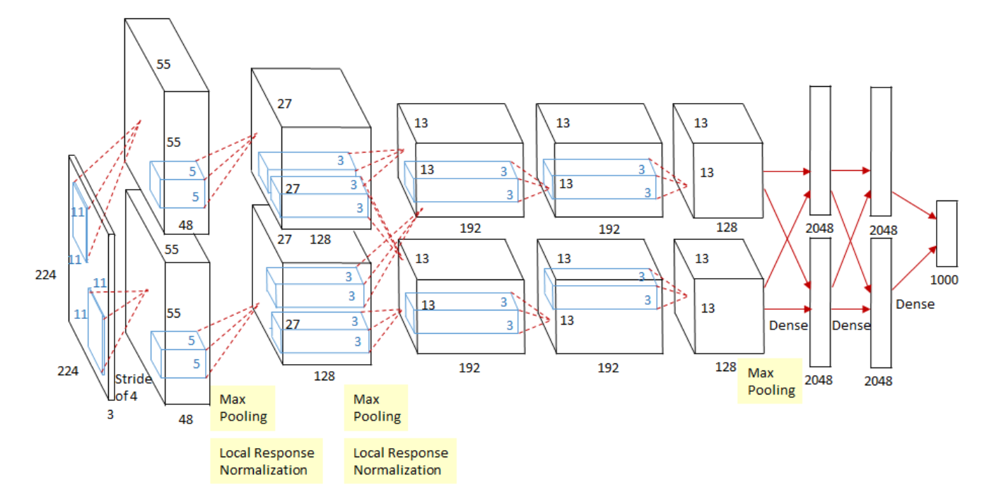
Alex Net
Created by Alex Krizhevsky and Ilya Sutskever in 2012
1st CNN model proposed to solve a problem
Was used in ImageNet
Caused The Boom in AI
5 Convolution Layers
3 Pooling Layer
3 Fully Connected Layers
60 Million Parameters

Slide 22
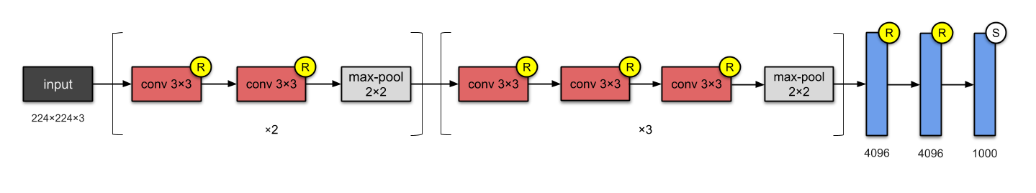
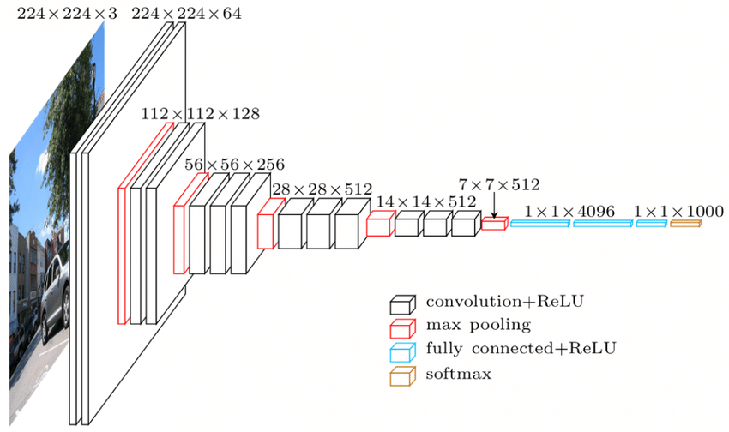
VGG-16
Created by Visual Geometry Group in 2012
1st CNN model proposed to solve a problem
Was used in ImageNet
Is quite bulky and produces model with large size
13 Convolution Layers
5 Pooling Layer
3 Fully Connected Layers
138 Million Parameters

Slide 23
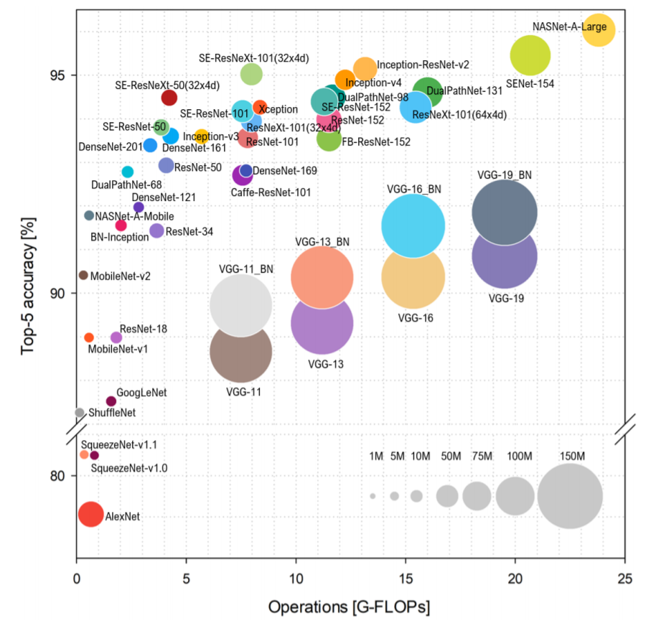
Comparison of CNN architectures
Simple CNN architectures are ineffective
Large Deeper architectures are accurate
Only Standard Architectures are presented
Most of the efficient algorithms are deeper
More operations, better accuracy
Most of the times Deeper the Better

Slide 24
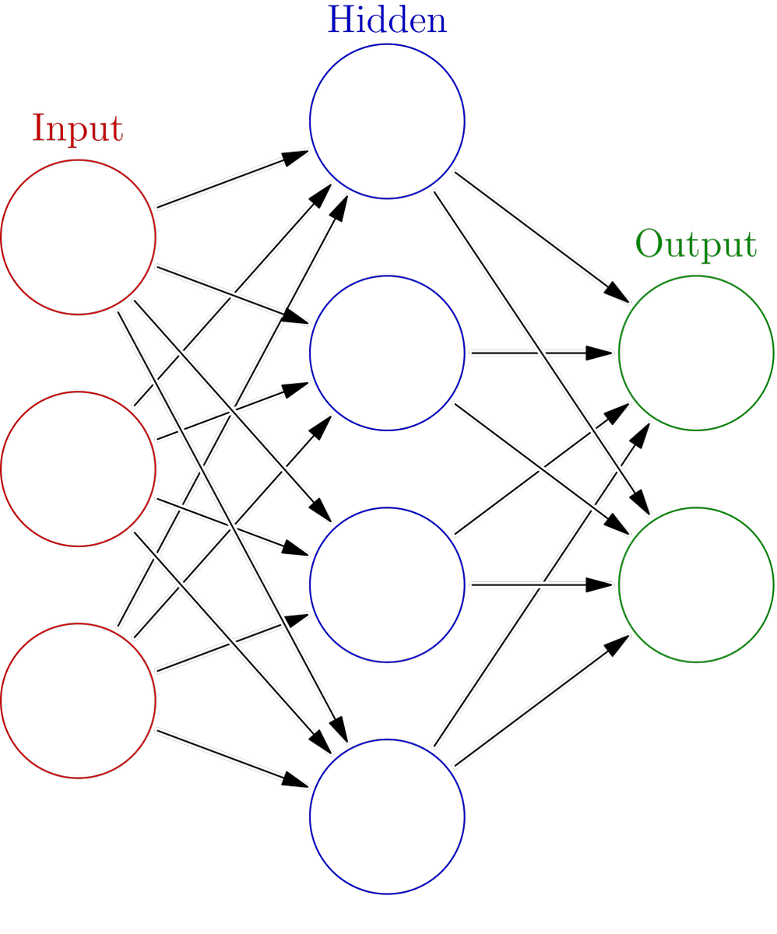
Solution:
Importing Required modules
Configure training Configurations
Allocate data and check configurations
Checking the contents of training dataset
Image Augmentation examples
Prepare training and validation data
Simple model creation and compiling
Training the model
Plotting the results
Using the model to predict test data

Slide 25
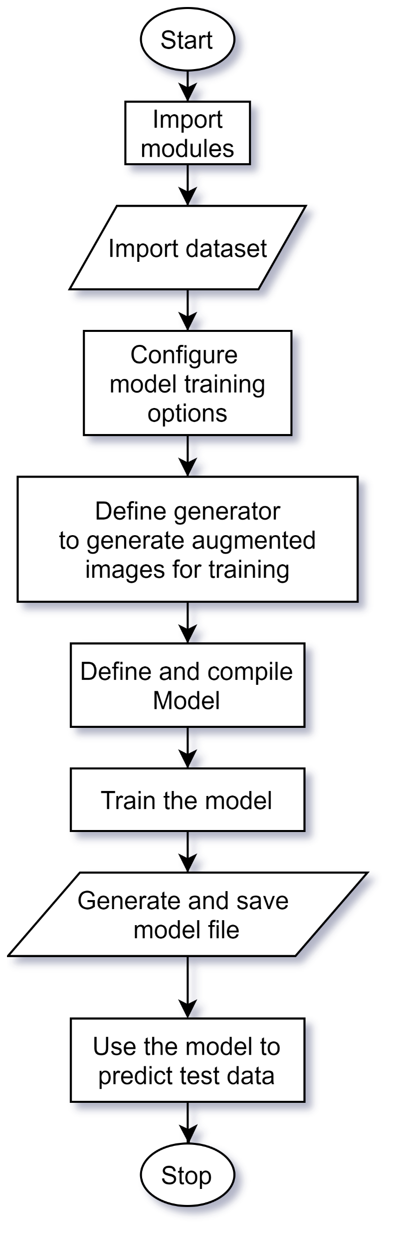
General Flowchart of the Solution
Importing Required modules
Configure training Configurations
Allocate data and check configurations
Checking the contents of training dataset
Image Augmentation examples
Prepare training and validation data
Simple model creation and compiling
Training the model
Plotting the results
Using the model to predict test data

Slide 26

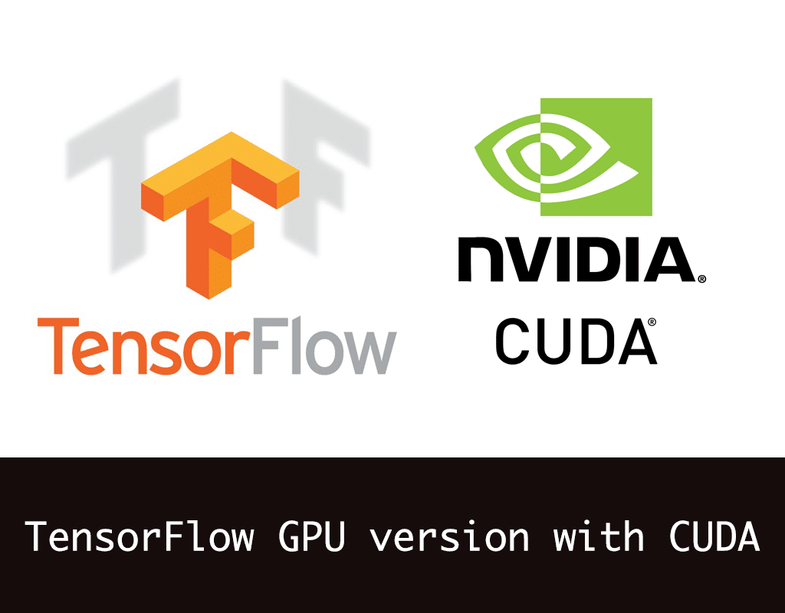
Importing Modules
The Basic modules are installed and loaded:
TensorFlow 2.1
Keras
NumPy
Pandas
Matplotlib
These packages were easily available in Colab and Kaggle Kernels
Nvidia CUDA, CUDNN and tensorflow-gpu is required for running it in a local machine
Using GPU for training is highly recommended due to the reduced training time
Pytorch is another Deep learning framework with more pythonic approach
Colab, Jupyter Notebook and Kaggle Kernels were used extensively

Slide 27
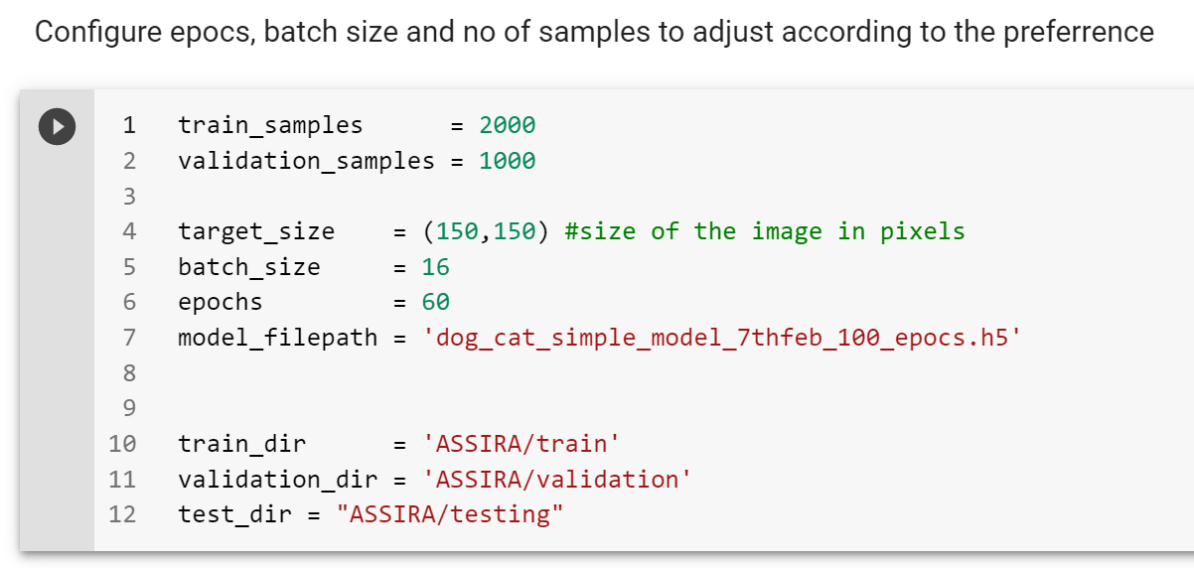
Configurations

Slide 28
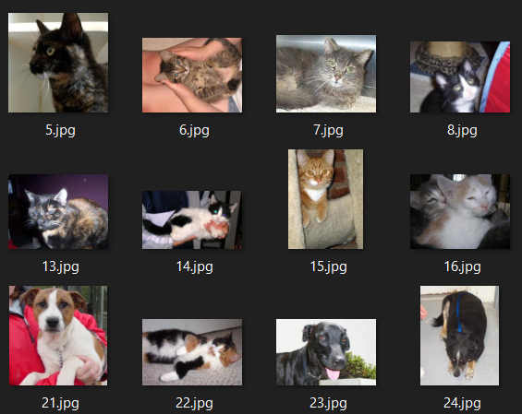
Data Allocation
The data used in this project is provided by ASIRRA
25000 Labelled data
12500 Unlabeled data
Only a small Fraction of the data is used
3000 Labelled data
1000 Unlabeled data
The Asirra4000 dataset is hosted in Kaggle for easier access through Kaggle kernel and Google Colab

Slide 29
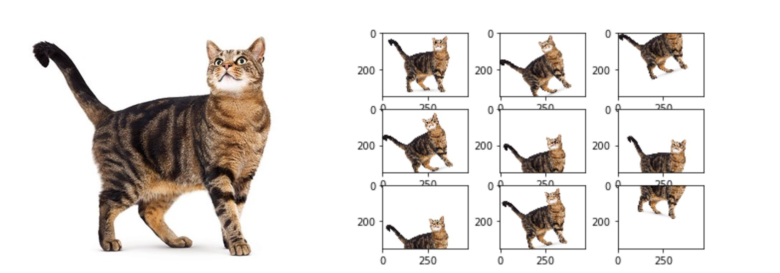
Image Augmentation
Since only a little amount of data was allocated for training
Data Augmentation increases the Dataset greatly
Various practices are to:
Flip
Rotate
Zoom
Color Change

Slide 30
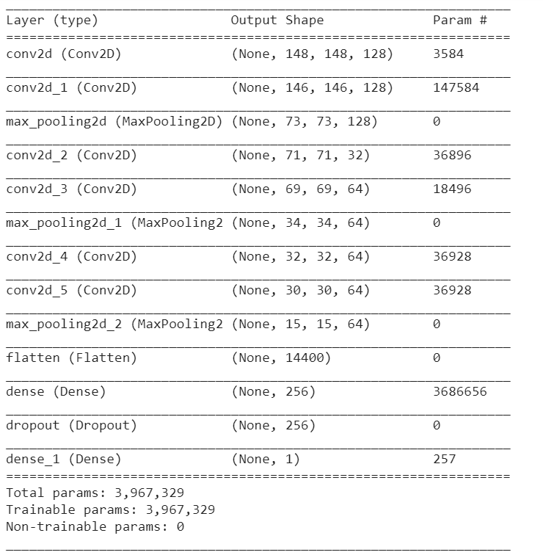
Model Creation
model = Sequential()
model.add(Conv2D(128, (3, 3), input_shape=(150,150,3), activation='relu'))
model.add(Conv2D(128, (3, 3), input_shape=(150,150,3), activation='relu'))
model.add(MaxPooling2D(pool_size=(2, 2)))
model.add(Conv2D(32, (3, 3), activation='relu'))
model.add(Conv2D(64, (3, 3), activation='relu'))
model.add(MaxPooling2D(pool_size=(2, 2)))
model.add(Conv2D(64, (3, 3), activation='relu'))
model.add(Conv2D(64, (3, 3), activation='relu'))
model.add(MaxPooling2D(pool_size=(2, 2)))
model.add(Flatten())
model.add(Dense(256, activation='relu'))
model.add(Dropout(0.5))
model.add(Dense(1, activation='sigmoid'))

Slide 31
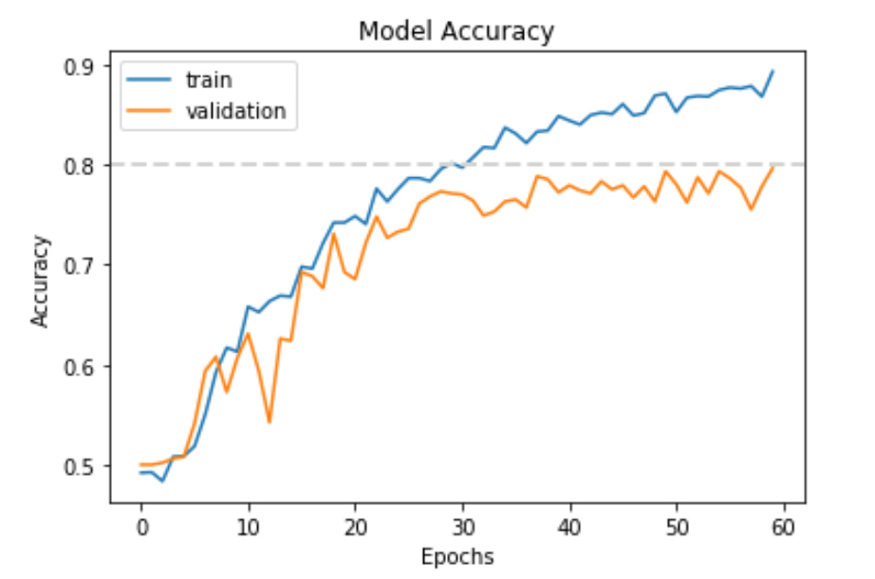
Training model
The Designed model is then trained by providing training data generated by image augmentation
The Validation data is used for validation
Configuration defines the:
Name of model
Epochs
Batch Size
Samples
Steps for training/validation
The Trained Model is then Saved to be used later
The History of the model is saved `

Slide 32
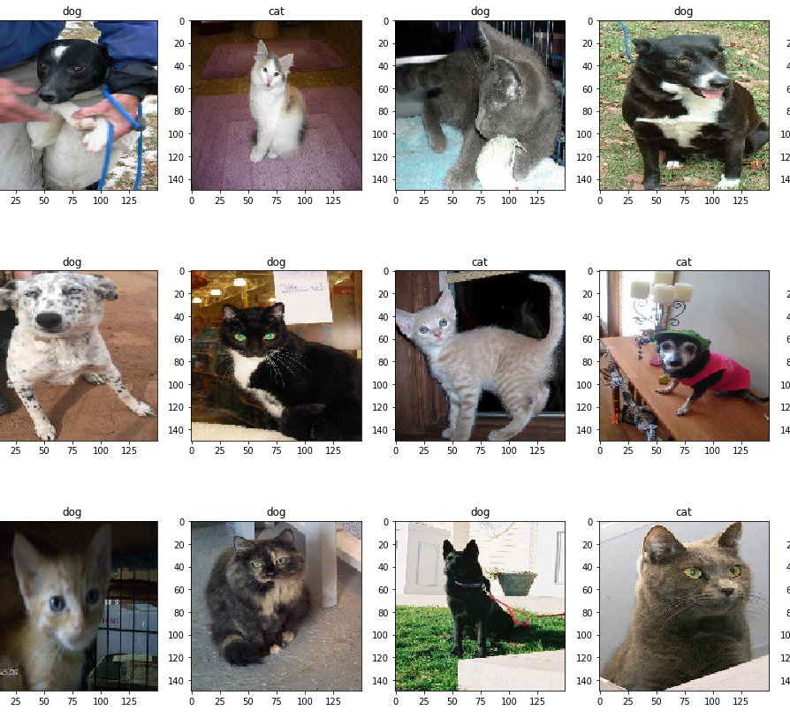
Results:
Validation accuracy 79%
Good Enough
Can be significantly improved

Slide 33
How to increase Accuracy?
Adding more data
Going Deeper (Using deeper NN)
Transfer learning
Using modern CNN architectures

Slide 34
Applications of CNN
The Dog/Cat classifier might seem silly but the same mechanisms can be used for other critical Areas such as:
Medical Fields:
Recognizing Cancer
Recognizing Abnormalities
Security:
Face Recognition
Biometrics
Weather Forecast
Self Driving Cars

Slide 35

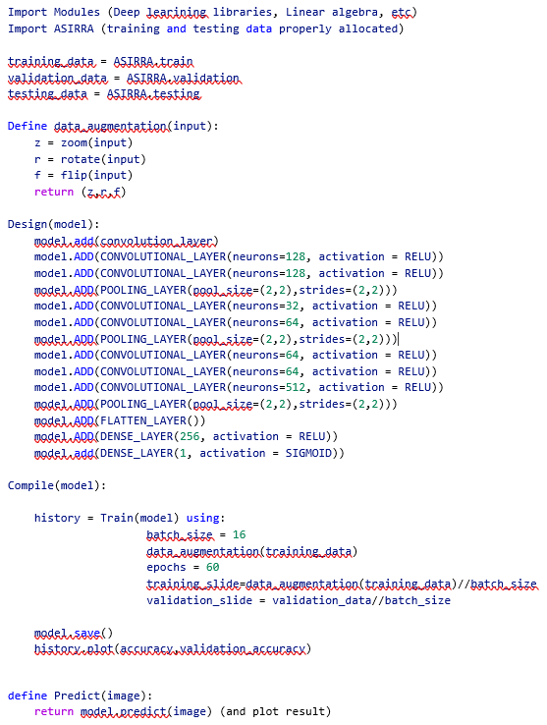
Pseudocode & Flowchart

Slide 36
Notebooks developed in colab:
Full notebook
https://colab.research.google.com/drive/1YJp7ch1YGga7GiXqizX4bBvevImG1IDM#scrollTo=fC69LnUIoc0B
Only Classifier
https://colab.research.google.com/drive/1bpGEKIUoau246KLvnGxzA8eYTgPpa0wU
Dataset required:
https://www.kaggle.com/kasudy/assira4000divided
Or
https://www.kaggle.com/c/dogs-vs-cats-redux-kernels-edition/data (requires to be allocated)

Slide 37
Thank You!

